Slide 1

Design of classifiers
Dr. Umarani Jayaraman
Assistant Professor

Slide 2
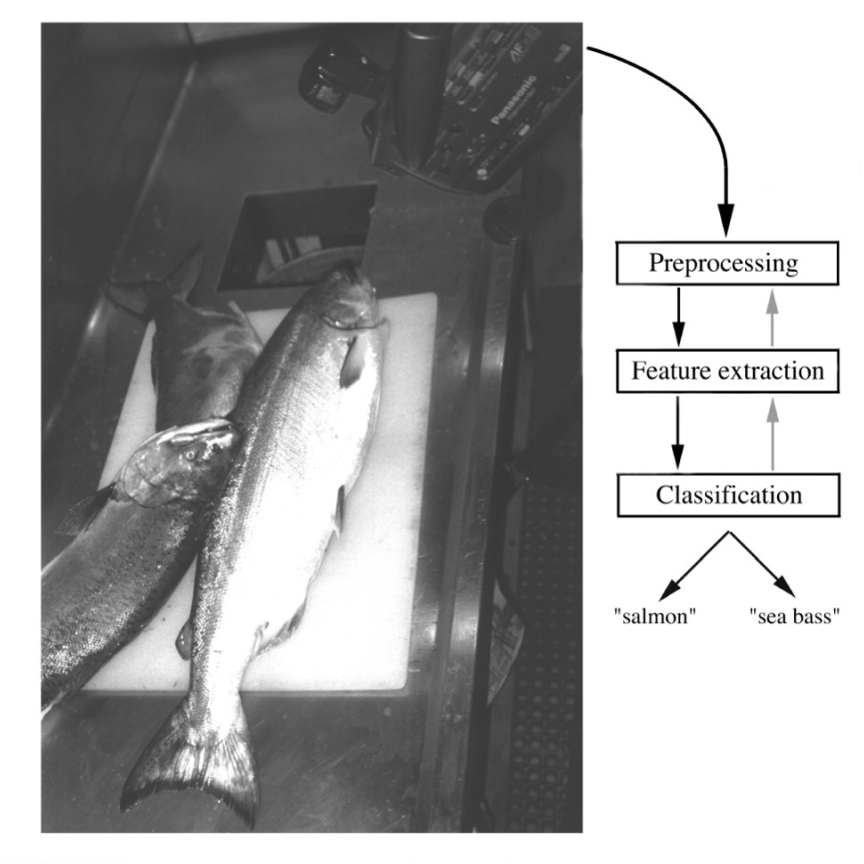
A simple PR problem
Problem: Sorting incoming fish on a conveyor belt.
Assumption: Two kind of fish:
(1) sea bass
(2) salmon

Slide 3
Challenges of PR- Feature Extraction
Correlated features / Redundant Features
Large number of features /Curse of dimensionality
Noise in measurements/ Noisy or Missing Features
Large variation within class: A lot of variability in patterns (feature vector) of a single class, the intra-class similarity is low
Feature vectors of patterns from different classes can be arbitrarily close, and inter-class similarity is high
Given this much variability, it is not so easy to design the classifier

Slide 4
Problem of classification
Classification: the process of assigning an object to one of the known classes (true class)
It does the task by Learning
Ideally, a classifier should have
Good generalization

Slide 5
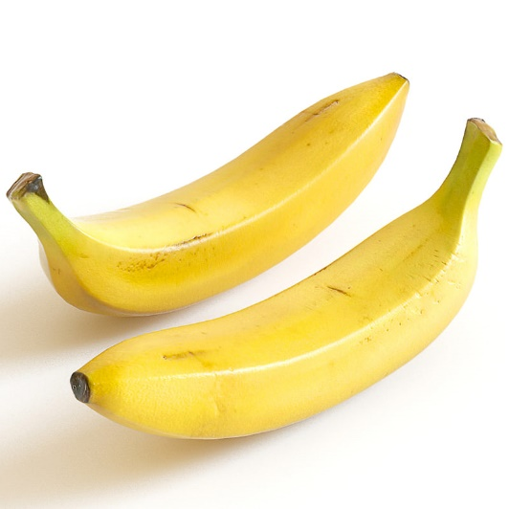
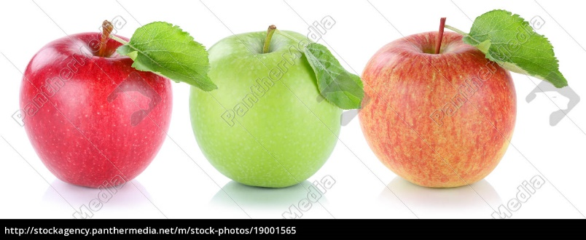
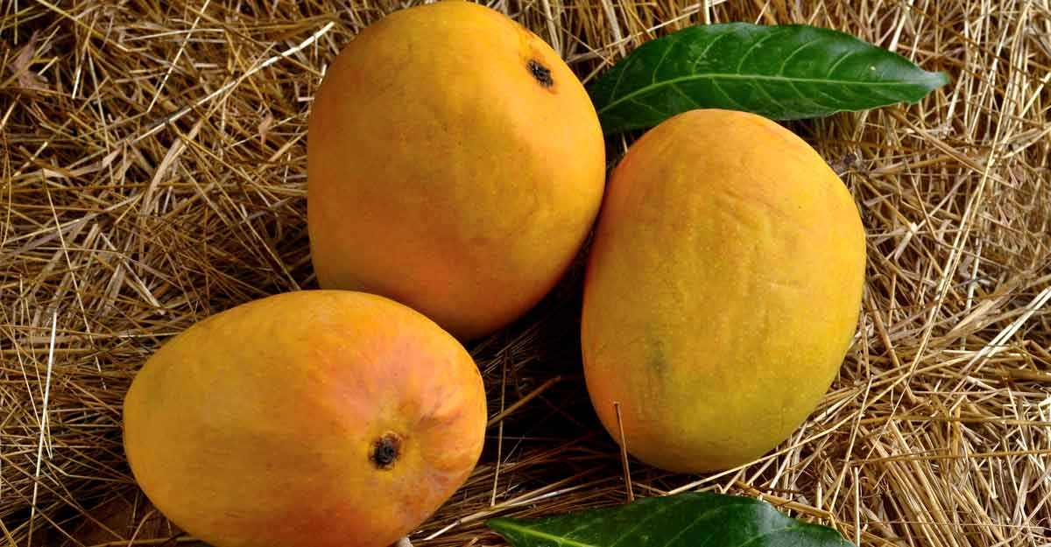
What do we have?
The only information is available for the design is – A training set of sample/example pattern
Training set: (X_{j} , y_{i})
Here X_{j} is a sample of class y_{i}

Slide 6
How do we generate the training set?
Generation of the training set- take representative patterns of the known category called data collection
Obtain the feature vectors from those data (choice of feature measurements)
Now learn an appropriate function h as the classifier
Test and validate the classifier on more/unseen data

Slide 7
A simple PR problem
Problem: Sorting incoming fish on a conveyor belt.
Assumption: Two kind of fish:
(1) sea bass
(2) salmon

Slide 8
Design of classifier:
A classifier ax₁+bx₂
If ax₁+bx₂ > T then sea bass, otherwise it is salmon
a,b,T are known as learning parameters
What values to use for a,b,T ?
x₁: length
x₂: lightness

Slide 9
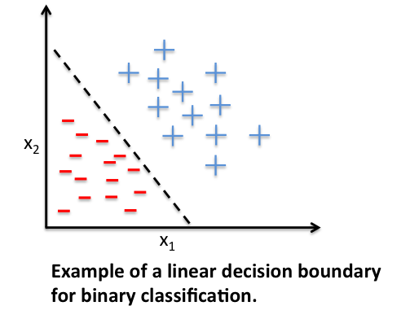
Design of classifier:
The classifier is linear here
x₁: length
x₂: lightness

Slide 10
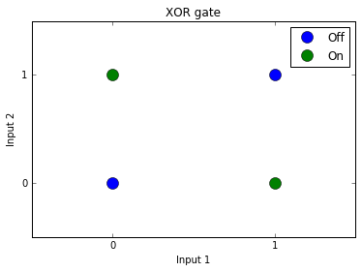
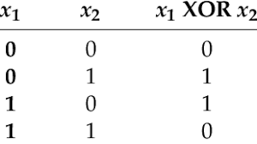
Another example
XOR Gate
The classifier is non-linear here

Slide 11
Learning from samples/examples
Designing a classifier is a typical problem of learning from samples/ examples
Also called learning with a teacher
Nature of feedback from a teacher can be different in the context of PR
Problem
Answer
Learner
Feedback
Teacher

Slide 12
Learning from examples
In the context of PR
Supervised Learning: The teacher gives the true class label for each feature vector
Unsupervised Learning: No teacher input (clustering problem)
Reinforcement Learning: Noisy assessment of performance (eg: correct/incorrect)
Feature Vector
Classifier
Class
Feedback
Teacher

Slide 13
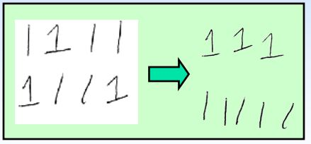
Learning from examples
Unsupervised Learning: No teacher input (clustering problem)
Clustering (learning categories)

Slide 14
Learning from examples
When the class labels of training patterns as given by teacher are noisy, we consider it as supervised learning with noise or classification noise
We design a classifier with training samples (learning from examples)
Many classifier algorithms do supervised learning

Slide 15
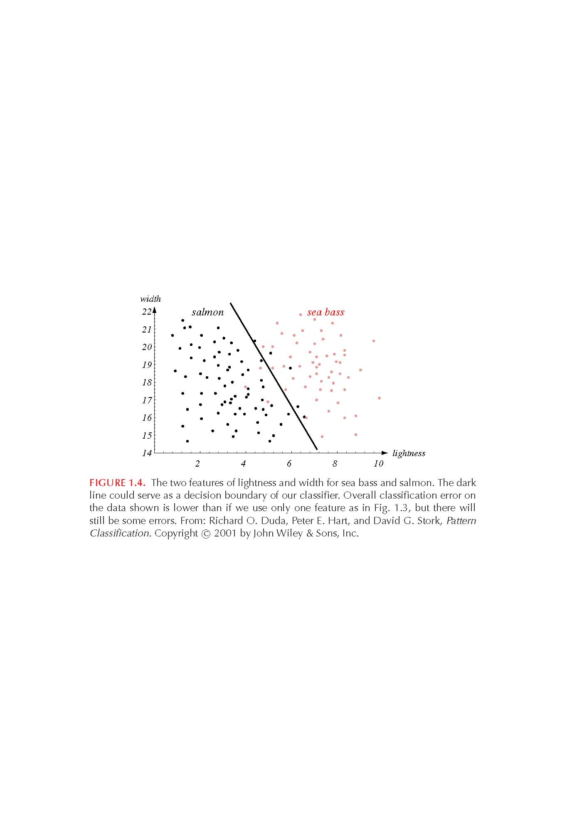
Design of classifier
If the classes are linearly not separable then partition the feature space into two regions by finding the decision boundary that minimizes the error.
How should we find the optimal decision boundary?

Slide 16
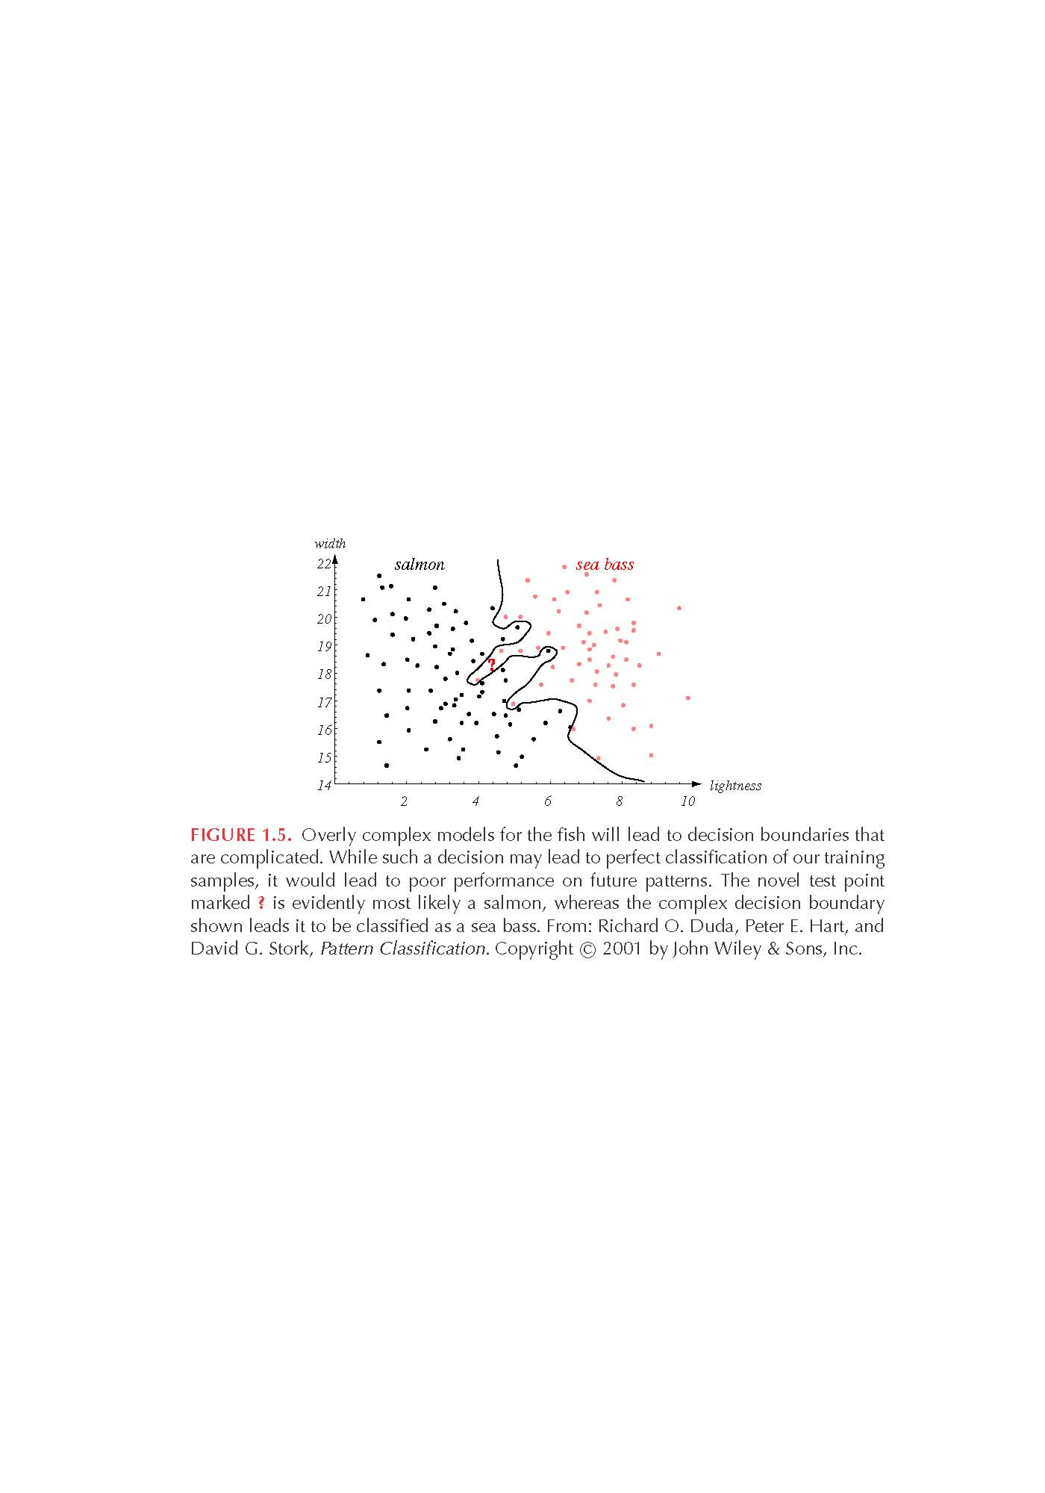
Design of classifier- complex model
We can get perfect classification performance on the training data by choosing complex models.
Complex models are tuned to the particular training samples, rather than on the characteristics of the true model.
overfitting
How well can the model generalize to unknown samples?

Slide 17
Design of classifier- complex model
If an algorithm works well on the training set but fails to generalize on test data (unseen data), it is called the problem of generalization or overfitting.

Slide 18
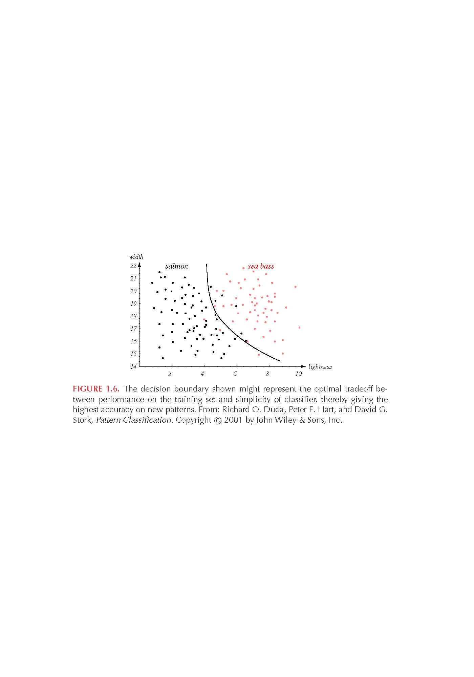
Generalization
Generalization is defined as the ability of a classifier to produce correct results on unseen (novel) patterns.
How can we improve generalization performance ?
More training examples (i.e., better model estimates).
Simpler models usually yield better performance.
complex model
simpler model

Slide 19
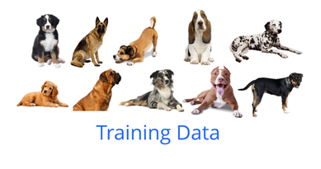
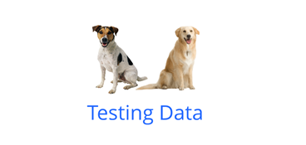
Generalization - example
12 total breeds of dogs within those pictures
Out of 10 are in training and 2 for testing

Slide 20
Generalization - example
This concept of learning from some data and correctly applying the gained knowledge on other data is called generalization.

Slide 21
Generalization
Many techniques are available to improve generalization
Regularization- L1 and L2
Dropout
Early stopping

Slide 22
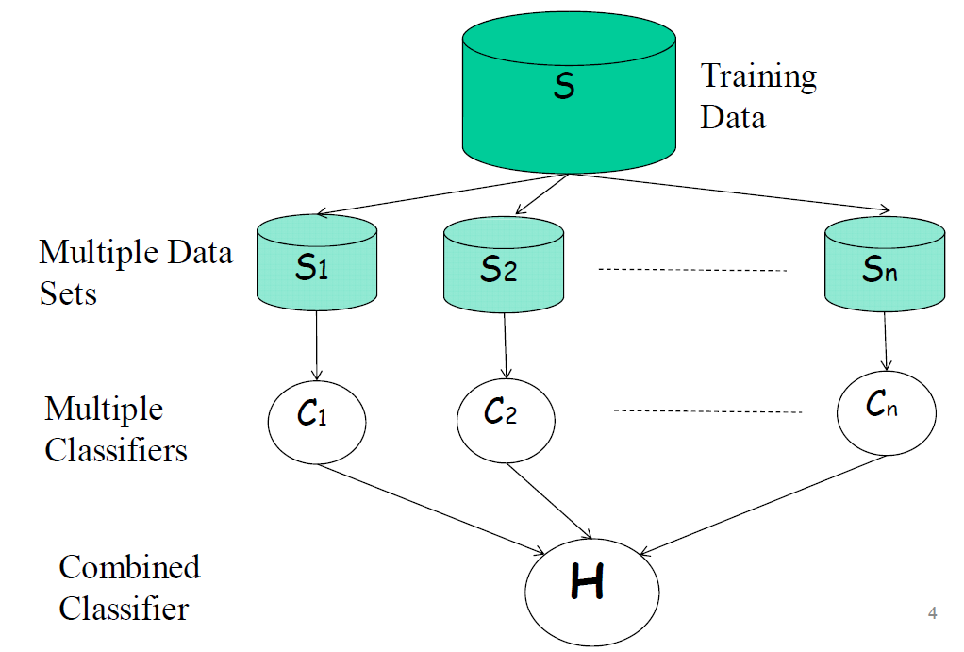
Design of classifier
Ensembles of Classifiers
Performance can be improved using a "pool" of classifiers.
How should we build and combine different classifiers ?

Slide 23
Summary
Classifiers
Linear and non-linear classifiers
Supervised learning
Unsupervised learning
Reinforcement learning
generalization

Slide 24
Thank you

